Slide 1
Codebasics Resume Project Challenge #6
Challenge: Provide Insights to Marketing Team in
Food & Beverage Industry
Presented by Devarapu Lokesh

Slide 2
Introduction
CodeX is a German beverage company ,that aims to make its mark in Indian market
A few months ago , launched their energy drink in 10 cities in india.
Their marketing team is responsible for increasing brand awareness, market reach, so they conducted a survey from 10k respondents in 10 cities of india.
Peter pandey (marketing data analyst ) is tasked to convert survey results into meaningful insights.
Task: Imagine yourself as peter pandey (Marketing Data analyst) and provide insights.

Slide 3
Survey
Survey consists of 24 Questions in various category as
Demographics
Consumption habits
Awareness & perception
Product experience
Competitor experience
Ingredients & health
Marketing & packaging
Pricing & availability

Slide 4
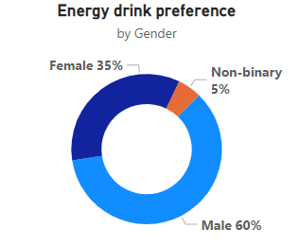
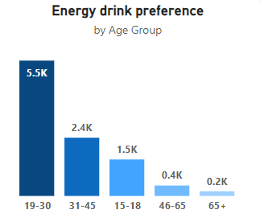
1. Demographic Insights
Who prefers energy drink more ?
Majorly Male (60%)
b. Which age groups prefer energy drink more?
Age group (19-30) prefer more of almost 50% in total respondents.
Target audience: Age group(15-30)

Slide 5
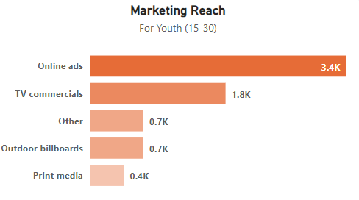
1. Demographic Insights
c. Which type of marketing reaches
the most Youth (15-30)
Mostly through online Ads & TV commercials
Recommendations:
1.increase online Ads & Tv commercials
2. Target youth(15-30) by providing vouchers, gift contests, Free subscriptions

Slide 6
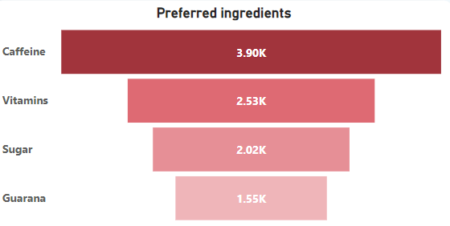
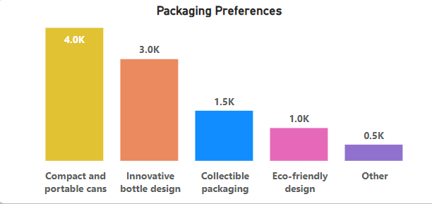
2. Consumer Preferences
What are the preferred ingredients of energy
drinks among respondents?
Mostly Caffeine & vitamins
b. What packaging preferences do respondents have for energy drinks?
Compact & portable cans with innovative bottle design

Slide 7
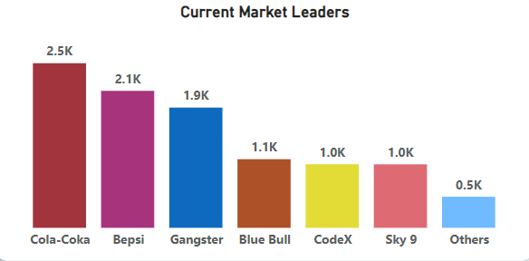
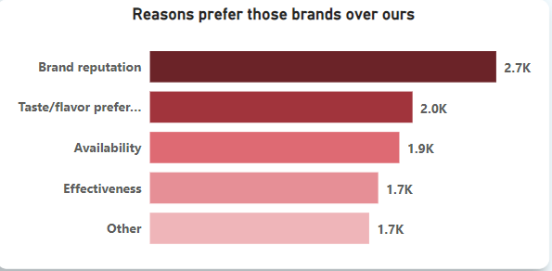
3. Competition Analysis
Who are the current market leaders?
Cola-coka & bepsi are current market leader
CodeX in 5Th position
b. What are the primary reasons consumers prefer
those brands over ours?
Brand reputation , flavors & Availability

Slide 8
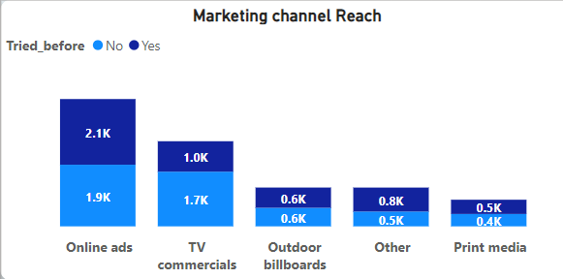
4. Marketing Channels and Brand Awareness
Which marketing channel can be used to reach more customers?
online Ads & TV commercials
b. How effective are different marketing strategies and channels in reaching our customers?
Marketing reach at 50% in every channel.
Recommendations:
Ads with preferred movies stars based on region
Sponser tv shows
Provide better discount

Slide 9
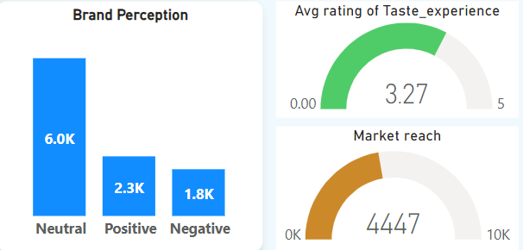
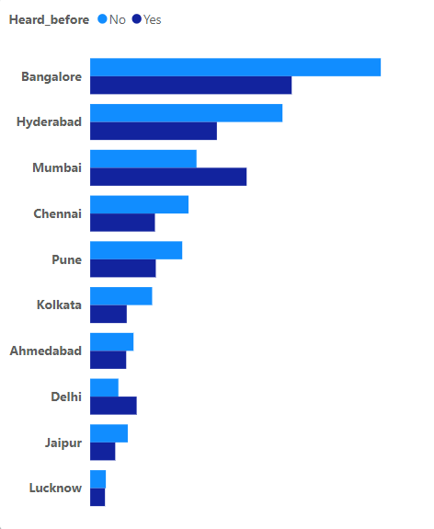
5. Brand Penetration
What do people think about our brand? (overall rating)
60% of consumers percept our Brand As Neutral
Avg rating of Taste experience who tried our drinks: 3.27/5
Brand Awareness : 44%
b. Which cities do we need to focus more on?
Bangolore, Hyderabad, Mumbai, Delhi has better market reach ,
So focusing on these cities more will increase product reach.

Slide 10
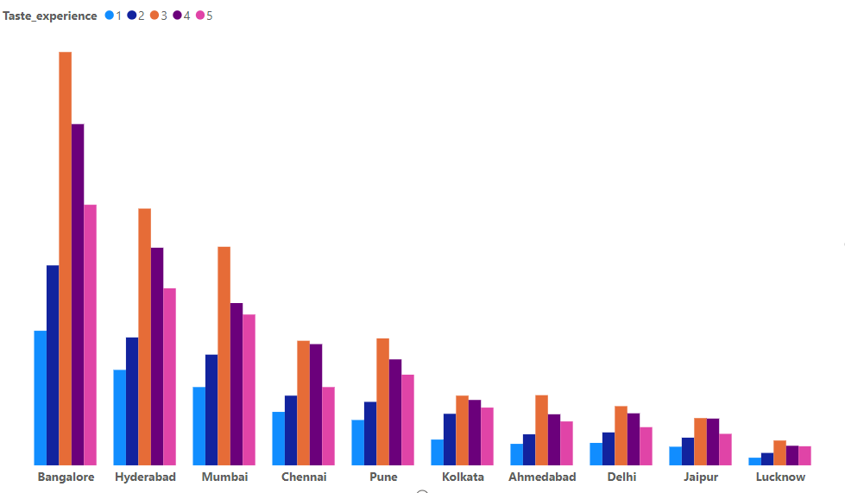
Taste Experience by cities
Bangalore , Hyderabad , Mumbai
Has better ratings
Focus on Tier1 cities

Slide 11
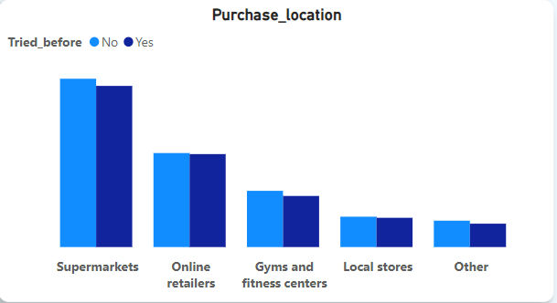
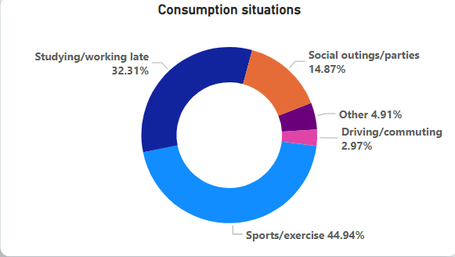
6. Purchase Behavior
Where do respondents prefer to purchase energy drinks?
Mostly in supermarkets , online retailers
b. What are the typical consumption situations for energy drinks among respondents?
77% situations in Sports/exercise & studying/working late

Slide 12
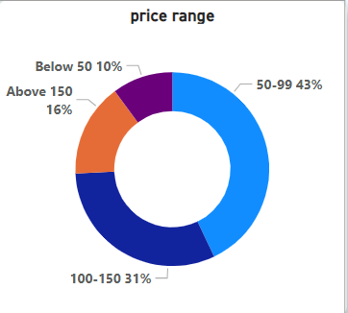
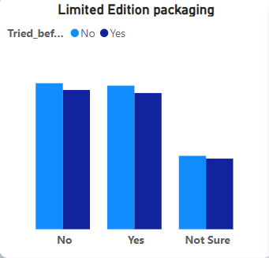
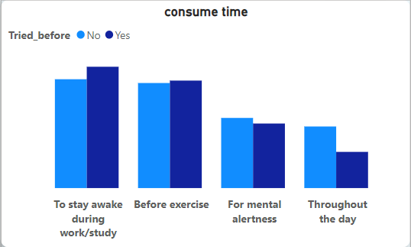
6. Purchase Behavior
c. What factors influence respondents' purchase decisions, such as price range and limited edition packaging?
Influencing factors: price ,consume time , availability
Limited edition packaging has no effect

Slide 13
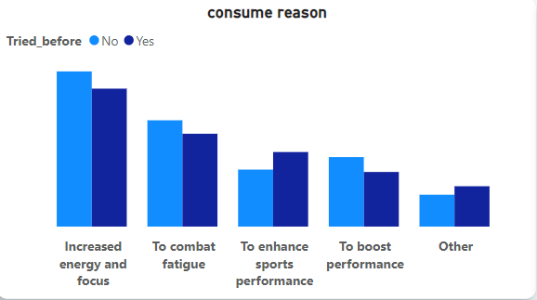
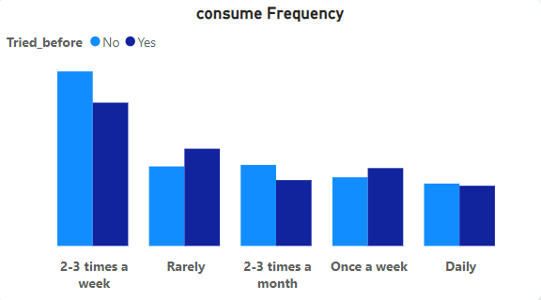
6. Purchase Behavior
Main reason to drink our brand is
To increase energy levels
To combat fatigue
To enhance sports

Slide 14
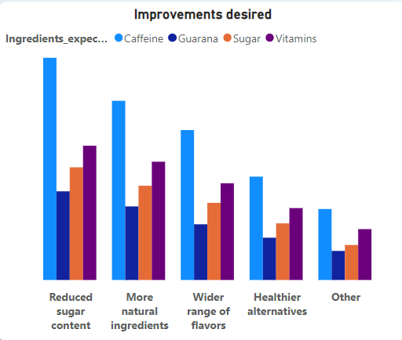
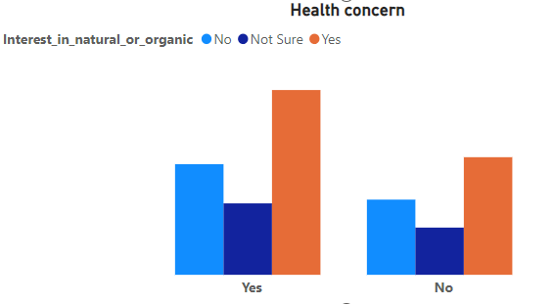
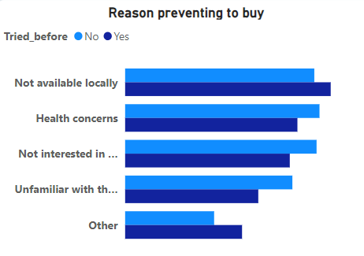
7. Product Development
Which area of business should we focus more on our product development? (Branding/taste/availability)
Focus more in branding & availability and some improvement in taste by reduced sugar & more natural ingredients
Target places: supermarkets ,Gyms ,Restaurents

Slide 15
Recommendations for CodeX
What immediate improvements can we bring to the product?
Improve flavors & availability
introduce new drinks with health concern like:
for Gym: special drinks for post & pre workout by adding ingredients like creatine , caffeine , l-arginine
Refreshing & boosting: add natural ingredients to elevate energy levels & make awareness of it.
2. What should be the ideal price of our product?
50-150 should be the ideal price based on survey.
3. What kind of marketing campaigns, offers, and discounts we can run?
online contests:conduct contests with amazing gifts , vouchers, subscriptions & make awareness in insta , snapchat…
offers: give offers like 2+1free, 5+1free
discounts: give discounts to bulk products, seasonal discounts.
make a trend: create insta , snapchat filters, stickers & create trends

Slide 16
4. Who can be a brand ambassador, and why?
sports man or movie stars with iconic physiques would be a best ambassador
because:
most of consumers drink to elevate energy levels & during exercise & an ad with a context of elevating energy levels & performance is suggested
5.Who should be our target audience, and why?
Age group of (15-30) and sports man , bodybuilders would be target audience because most of consumers reason is to elevate energy levels
6. Where should be our target place to catch more product reach?
supermarkets , fitness centers, restaurants , movie theatres.

Slide 17
Thank You

